Slide 1
HTML Form

Slide 2
Froms
HTML Forms are required, when you want to collect some data from the site visitor. For example, during user registration you would like to collect information such as name, email address, credit card, etc.
A form will take input from the site visitor and then will post it to a back-end application such as PHP script etc. The back-end application will perform required processing on the passed data based on defined business logic inside the application.
There are various form elements available like text fields, textarea fields, drop-down menus, radio buttons, checkboxes, etc.

Slide 3
Form Syntax
<form action = "Script URL" method = "GET|POST"> form elements like input, textarea etc.
</form>

Slide 4
Form Attributes
Attribute | Description
action | Backend script ready to process your passed data.
method | Method to be used to upload data. The most frequently used are GET and POST methods.
target | Specify the target window or frame where the result of the script will be displayed. It takes values like _blank, _self, _parent etc.
enctype | You can use the enctype attribute to specify how the browser encodes the data before it sends it to the server. Possible values are − application/x-www-form-urlencoded − This is the standard method most forms use in simple scenarios. mutlipart/form-data − This is used when you want to upload binary data in the form of files like image, word file etc.

Slide 5
Form Controls
Text Input Controls
Checkboxes Controls
Radio Box Controls
Select Box Controls
File Select boxes
Hidden Controls
Clickable Buttons
Submit and Reset Button

Slide 6
Text Input Controls
There are three types of text input used on forms −
Single-line text input controls − This control is used for items that require only one line of user input, such as search boxes or names. They are created using HTML <input> tag.
Password input controls − This is also a single-line text input but it masks the character as soon as a user enters it. They are also created using HTMl <input> tag.
Multi-line text input controls − This is used when the user is required to give details that may be longer than a single sentence. Multi-line input controls are created using HTML <textarea> tag.

Slide 7
Example
<!DOCTYPE html>
<html>
<head>
<title>Text Input Control</title>
</head>
<body>
<form >
First name: <input type = "text" name = "first_name" />
<br> Last name: <input type = "text" name = "last_name" />
</form>
</body>
</html>

Slide 9
Multiple-Line Text Input
This is used when the user is required to give details that may be longer than a single sentence. Multi-line input controls are created using HTML <textarea> tag.

Slide 10
Example
<!DOCTYPE html> <html> <head> <title>Multiple-Line Input Control</title> </head> <body> <form> Description : <br /> <textarea rows = "5" cols = "50" name = "description"> Enter description here... </textarea> </form> </body> </html>

Slide 11
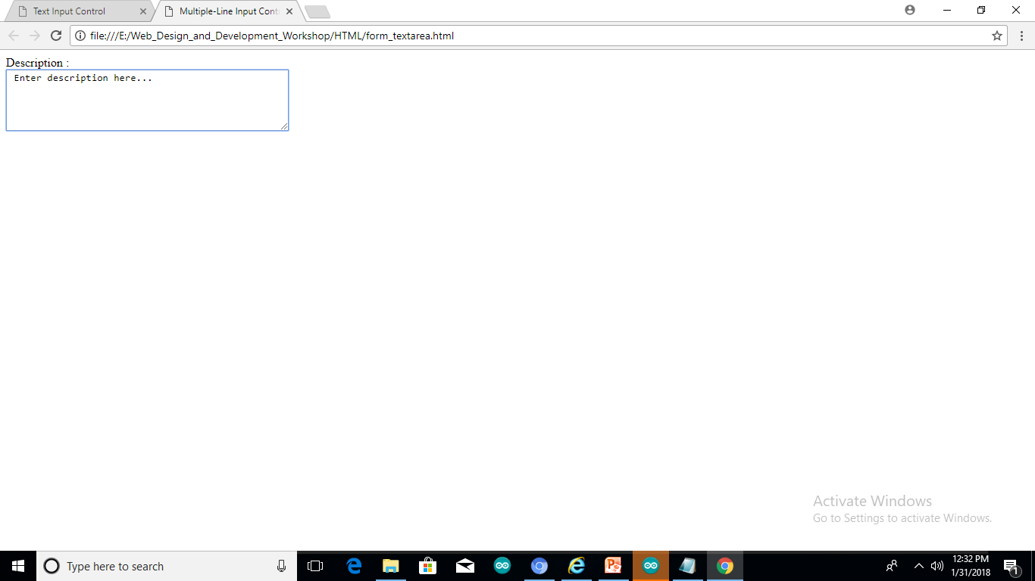
Example

Slide 12
Checkbox
Checkboxes are used when more than one option is required to be selected. They are also created using HTML <input> tag but type attribute is set to checkbox..

Slide 13
Example
<!DOCTYPE html> <html> <head> <title>Multiple-Line Input Control</title> </head> <body> <form> <input type = "checkbox" name = "maths" value = "on"> Maths <input type = "checkbox" name = "physics" value = "on"> Physics </form> </body> </html>

Slide 14
Radio buttons
Radio buttons are used when out of many options, just one option is required to be selected. They are also created using HTML <input> tag but type attribute is set to radio.

Slide 15
Example
<!DOCTYPE html> <html> <head> <title>Multiple-Line Input Control</title> </head> <body> <form> <input type = "radio" name = "subject" value = "maths"> Maths <input type = "radio" name = "subject" value = "physics"> Physics </form> </body> </html>

Slide 16
Select Box Control
A select box, also called drop down box which provides option to list down various options in the form of drop down list, from where a user can select one or more options.

Slide 17
Example
<!DOCTYPE html> <html> <head> <title>Multiple-Line Input Control</title> </head> <body> <form> <select name = "dropdown"> <option value = "Maths" selected>Maths</option> <option value = "Physics">Physics</option> </select> </form> </body> </html>

Slide 18
File Upload Box
If you want to allow a user to upload a file to your web site, you will need to use a file upload box, also known as a file select box. This is also created using the <input> element but type attribute is set to file.

Slide 19
Example
<!DOCTYPE html> <html> <head> <title>Multiple-Line Input Control</title> </head> <body> <form> <input type = "file" name = "fileupload" accept = "image/*" /> </form> </body> </html>

Slide 20
Button Controls
Sr.No | Type & Description
1 | submit This creates a button that automatically submits a form.
2 | reset This creates a button that automatically resets form controls to their initial values.
3 | button This creates a button that is used to trigger a client-side script when the user clicks that button.
4 | image This creates a clickable button but we can use an image as background of the button.

Slide 21
Example
<!DOCTYPE html> <html> <head> <title>Multiple-Line Input Control</title> </head> <body> <form> <input type = "submit" name = "submit" value = "Submit" /> <input type = "reset" name = "reset" value = "Reset" /> <input type = "button" name = "ok" value = "OK" /> <input type = "image" name = "imagebutton" src = "/html/images/logo.png" /> </form> </body> </html>

Slide 22
Date,Color,Email,number,range,
<!DOCTYPE html> <html> <head> <title>Multiple-Line Input Control</title> </head> <body> <form> <input type="color" name="favcolor"> <input type="date" name="bday"> <input type="email" name="email"> <input type="number" name="quantity" min="1" max="5"> <input type="range" name="points" min="0" max="10"> <input type="tel" name="usrtel"> </form> </body> </html>

